Slide 1





A Generative Adversarial Framework for Bounding Confounded Causal Effects
Yaowei Hu¹, Yongkai Wu², Lu Zhang¹, Xintao Wu¹
¹University of Arkansas
²Clemson University

Slide 2
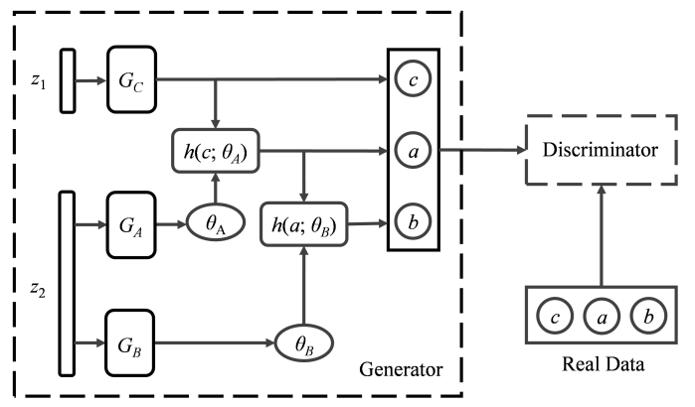
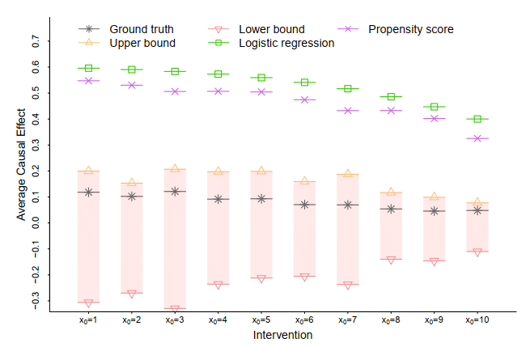
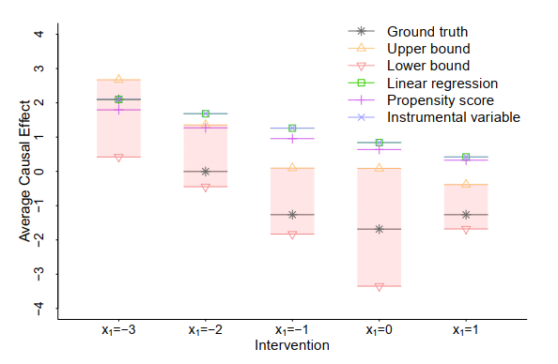
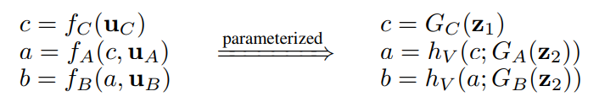

A Generative Adversarial Framework for Bounding Confounded Causal Effects
Unidentifiable Problem
Proposed Framework
confounding effects
Framework: We propose to parameterize the unknown exogenous random variables and structural equations of a causal model using neural networks and implicit generative models.
- Estimate response functions from $PAV$ to $V$ by neural networks with a certain network structure.
- Use the implicit generative model to generate the distribution for the response-function variable.
- Parameterize the causal model by expressing it with response-function variables.
- Formulate an adversarial learning problem for computing the bounds of the ACE.
When hidden confounders exist, the ACE may not be uniquely calculated from the observational data without further assumptions, known as the unidentifiable problem.
Confounders
A
B
Goal: How to bound ACEs to continuous and possibly high dimensional variables when hidden confounders exist.
causal effects
Experiments
Example
Causal graph and equations
Architecture of neural networks
Results of synthetic dataset
Results of adult dataset
c-component
c-component
U
C
A
B

